Slide 1
Azure Monitor and Log Analytics
John Deardurff

Slide 2

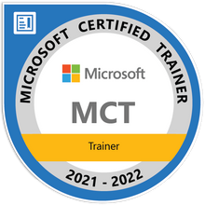

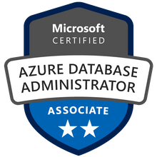



John Deardurff
Microsoft Customer Engineer (Global Technical Team)
Microsoft Certified Trainer (Regional Lead)
MVP: Data Platform (2016 – 2018)
Email: John.Deardurff@Microsoft.com
Twitter: @SQLMCT
Website: www.SQLMCT.com
GitHub: github.com\SQLMCT
Notes:
While all this has been running, several other parts of SQLOS have been active:
Monitoring: DMVs, Extended Events (xEvents), and so on.
Deadlock Monitor thread: Monitors for and deals with deadlocks.
Lazy Writer threads: Clock sweeping the buffer pool to maintain the free lists and responsible for writing dirty pages to disk between checkpoints.
Scheduler Monitor thread: Monitors scheduler health and detects issues such as non-yielding scenarios.
Resource Monitor thread: Monitors available memory from operating system and internal to SQL Server and notifies the Clerks.
The Hosting APIs for external components interface with Microsoft Data Access Components (MDAC) and common language runtime (CLR).
The Storage Engine manages all data access, both through transaction-based commands (with the Transaction Manager) and bulk operations such as backup, bulk insert, and certain Database Console Command (DBCC) commands.
Access Methods is an important component of the Storage Engine, and contains components to open a table, retrieve qualified data, and update data.
The Access Methods code does not actually retrieve the pages, it will make a request to the Buffer Manager, which holds a copy of the requested data pages in memory (and if the requested page is not in memory, it will retrieve it from disk). By memory, we mean specifically the Buffer Pool, which is part of the SQLOS.
The Transaction Manager ensures that transactions adhere to the ACID properties: atomicity, consistency, isolation, and durability.
It also outlines the boundaries of statements that must be grouped together to form an operation, and it allows “nested” transactions by managing savepoints, if any. Furthermore, it also coordinates with the Lock Manager regarding when locks can be released, based on the isolation level in effect. It also coordinates with Access Methods to determine when old versions of rows are no longer needed and can be removed from the version store.
The File Manager handles actual physical access to data and log files, as well as access to backup devices.
Also included in the storage engine are components for controlling utilities such as Bulk Load, DBCC commands, and Backup/Restore operations.
The SQLOS layer handles activities that are normally considered to be operating system-like responsibilities, such as Thread Scheduling, Synchronization services (latching and deadlock detection), Memory management (including the Buffer Pool), Lock management, I/O management (which establish the completion routines for read/write operations from memory to disk and vice-versa) , and Monitoring (such as DMVs and xEvents).
Locking is a crucial function of a multi-user Remote Desktop Management Services (RDMS) such as SQL Server, even if you are operating an optimistic concurrency model such as snapshot isolation level, to help ensure the isolation and consistency properties of ACID. This is handled by the Lock Manager, whose main job is to provide hierarchical access to data in a concurrent fashion (as allowed by the Isolation Level of the transaction), by managing compatibility between the lock types. It also resolves deadlocks (with the aid of the Deadlock Monitor thread), and escalates locks if needed. Other components such as the other threads in the figure will be explained in an upcoming lesson in this module.

Slide 3
What does this session cover?
What is Azure Monitor?
Azure Monitor Metrics
Azure Monitor Alerts
Azure Monitor Logs
Demonstration

Slide 4

Azure Monitor Metrics and Alerts

Slide 5
Azure Monitor
Notes:
https://docs.microsoft.com/en-us/azure/azure-monitor/overview
Azure Monitor helps you maximize the availability and performance of your applications and services. It delivers a comprehensive solution for collecting, analyzing, and acting on telemetry from your cloud and on-premises environments. This information helps you understand how your applications are performing and proactively identify issues affecting them and the resources they depend on.
All data collected by Azure Monitor fits into one of two fundamental types, metrics and logs. Metrics are numerical values that describe some aspect of a system at a particular point in time. They are lightweight and capable of supporting near real-time scenarios. Logs contain different kinds of data organized into records with different sets of properties for each type. Telemetry such as events and traces are stored as logs in addition to performance data so that it can all be combined for analysis.
Log data collected by Azure Monitor can be analyzed with queries to quickly retrieve, consolidate, and analyze collected data. You can create and test queries using Log Analytics in the Azure portal. You can then either directly analyze the data using different tools or save queries for use with visualizations or alert rules.
Azure Monitor uses a version of the Kusto query language that is suitable for simple log queries but also includes advanced functionality such as aggregations, joins, and smart analytics. You can quickly learn the query language using multiple lessons. Particular guidance is provided to users who are already familiar with SQL and Splunk.

Slide 6
Azure Monitor Metrics
Azure Monitor Metrics stores numeric data in a time-series database, which makes this data more lightweight than Azure Monitor Logs and capable of supporting near real-time scenarios making them particularly useful for alerting and fast detection of issues
Notes:
https://docs.microsoft.com/en-us/azure/azure-monitor/essentials/data-platform-metrics
Azure Monitor Metrics is a feature of Azure Monitor that collects numeric data from monitored resources into a time series database. Metrics are numerical values that are collected at regular intervals and describe some aspect of a system at a particular time.
Metrics in Azure Monitor are lightweight and capable of supporting near real-time scenarios, so they're useful for alerting and fast detection of issues. You can analyze them interactively by using Metrics Explorer, be proactively notified with an alert when a value crosses a threshold, or visualize them in a workbook or dashboard.

Slide 7
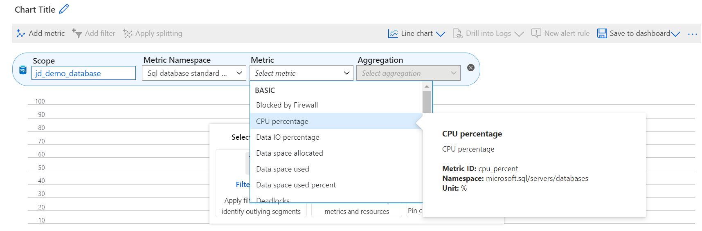
Azure Monitor Metrics

Slide 8
Azure Monitor Metrics
Metric Name | Aggregation Type | Minimum Alert Time Window
CPU percentage | Average | 5 minutes
Data IO percentage | Average | 5 minutes
Log IO percentage | Average | 5 minutes
DTU percentage | Average | 5 minutes
Total database size | Maximum | 30 minutes
Successful Connections | Total | 10 minutes
Failed Connections | Total | 10 minutes
Blocked by Firewall | Total | 10 minutes
Deadlocks | Total | 10 minutes
Database size percentage | Maximum | 30 minutes
In-Memory OLTP storage percent(Preview) | Average | 5 minutes
Workers percentage | Average | 5 minutes
Sessions percent | Average | 5 minutes
DTU limit | Average | 5 minutes
DTU used | Average | 5 minutes

Slide 9
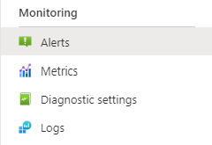
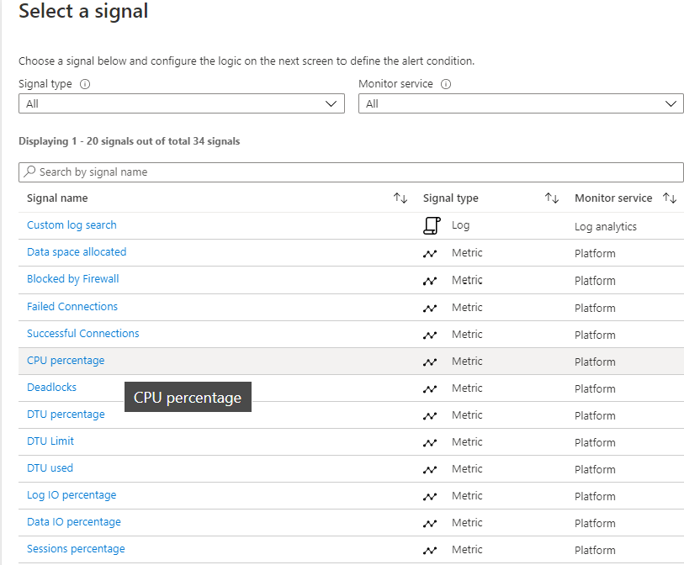
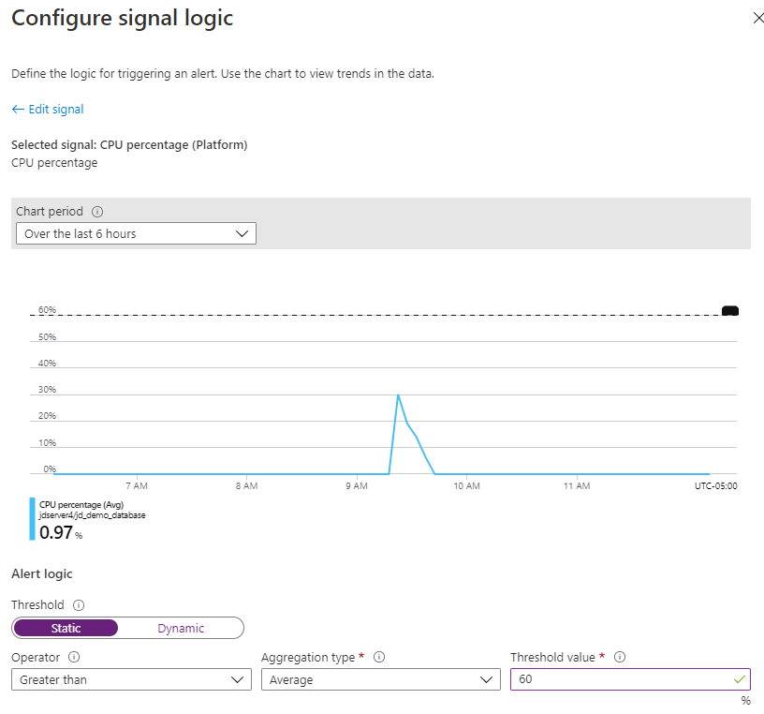
Azure Monitor Alerts - Conditions

Slide 10
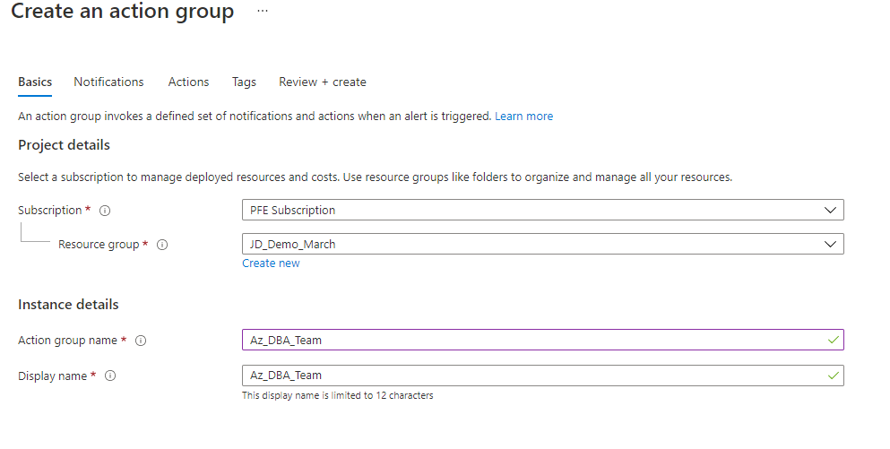
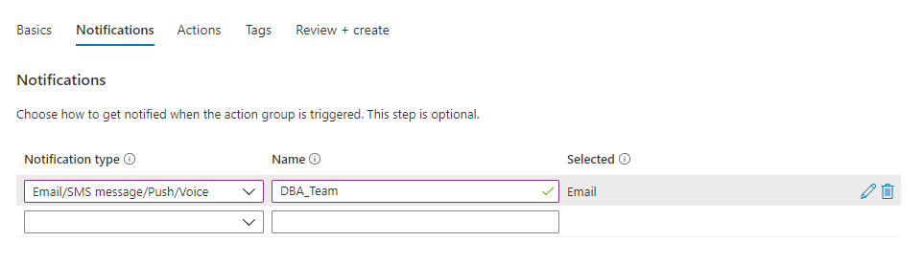
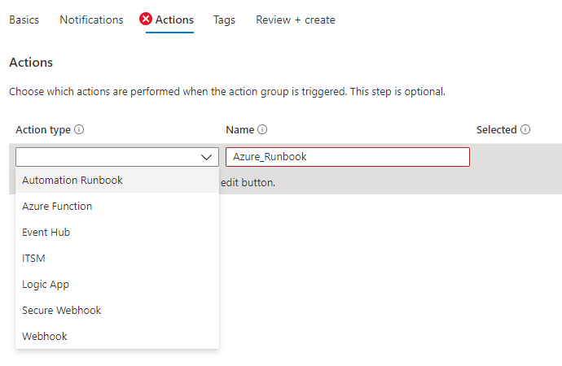
Azure Monitor Alerts – Action Groups

Slide 11
Azure Dashboards
Customizable
Pin:
Resources
Metrics
Log analytics charts
Text boxes
Private or shared
Back-up or copy
Download JSON – save for backup purposes
Replace references from one server/database to the other
Upload as new dashboard

Slide 12
Demonstration Time

Slide 13

Azure Log Analytics

Slide 14
What is Log Analytics?
Append-only log data
Queried using Kusto Query Language (KQL)
SQL-Like language
Cost
Pay-by-ingestion
Minimize cost by only pulling over needed metrics
Latency
10-15 minutes max latency

Slide 15
Enabling Log Analytics
Create a Log Analytics Workspace
Add new ‘Diagnostic setting’ to send logs to your workspace
Select which metrics you want to monitor

Slide 16
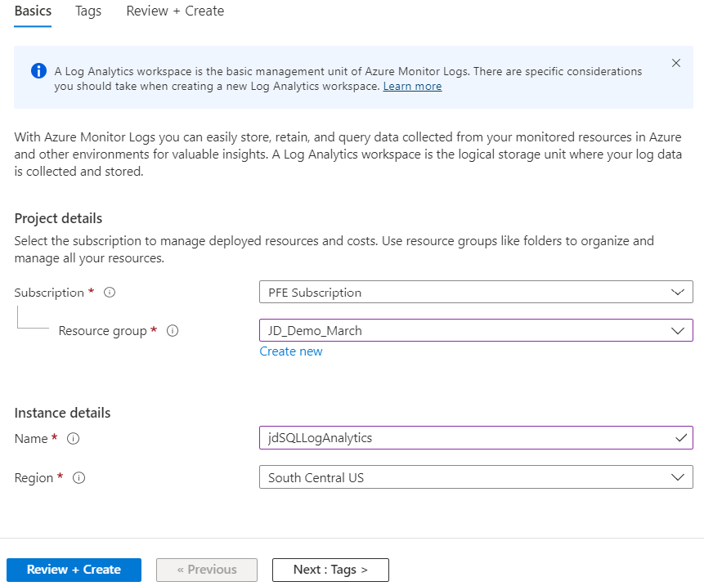
Create Log Analytics Workspace

Slide 17
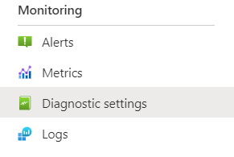
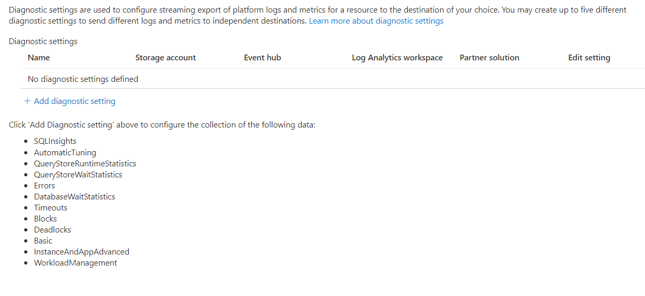
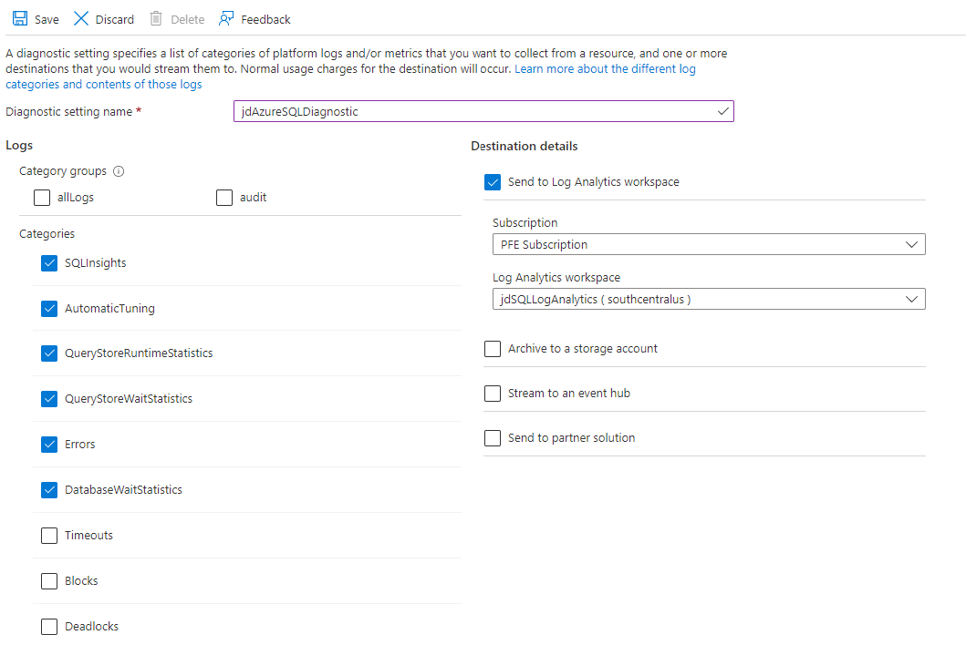
Configure Diagnostic Settings

Slide 18
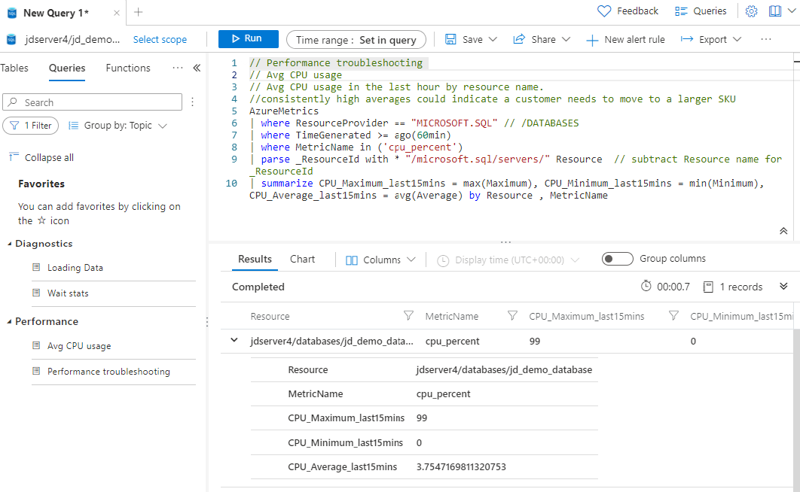
Querying Log Analytics (Avg CPU Usage)

Slide 19
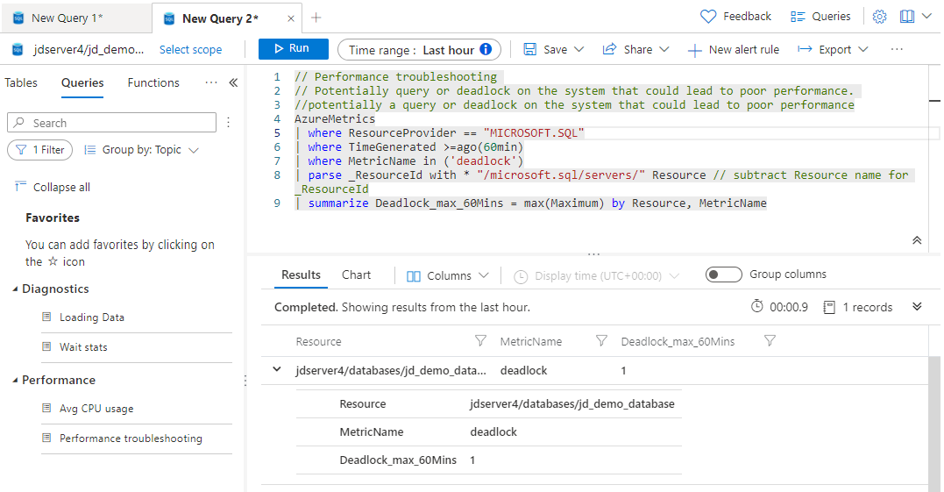
Querying Log Analytics (Deadlocks)

Slide 20
Azure Monitor SQL Insights
Environment for telemetry collection
Configure data collection frequency
Choose exactly which data to collect
Control the retention policy for the data
Create custom data collection rules
Monitor any SQL Deployment in Azure
Azure SQL Database
Azure SQL Managed Instance
SQL Server on Azure Virtual Machines
Broad custom visualization support
Visualize data using Monitor Workbooks
Integrates with open-source monitoring tools
Select from over 200 metrics
Notes:
https://www.bing.com/videos/search?q=azure+monitor+for+sql+database&view=detail&mid=4E8658E1D4FCABED82E14E8658E1D4FCABED82E1&FORM=VIRE

Slide 21
Demonstration

Slide 22
Questions?

Slide 23
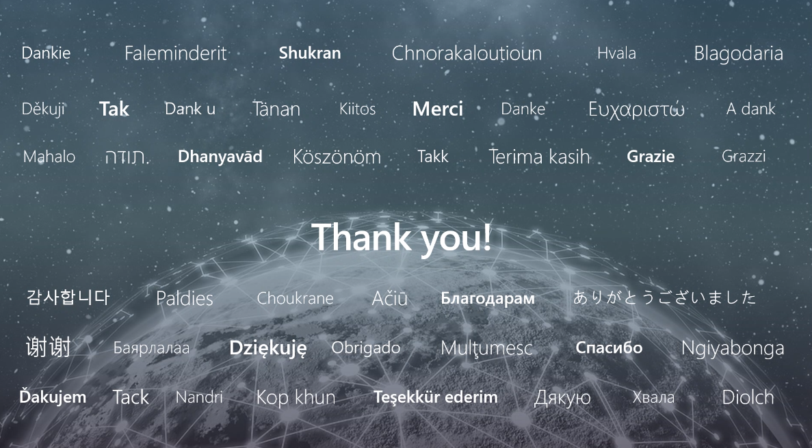

Slide 24
Microsoft

